Slide 1
Music Server
Using Mopidy

Slide 2
Summary:
To learn how to set up web client through mopidy as an application by editing configurations.
To learn how to install a music server whether its local or private streaming.
To understand how to control the volumes as you listen to music.
To learn how to boot Mopidy when system is at boot.

Slide 3
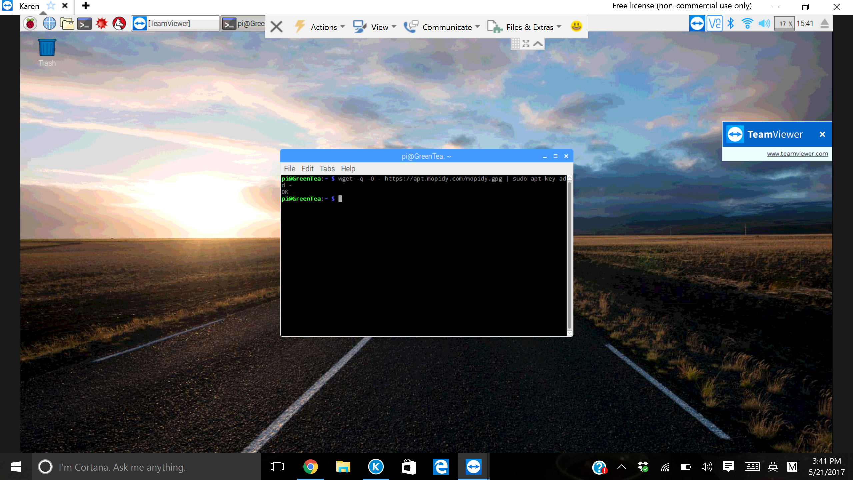

To add the archive’s GPG key:
Add the APT repo to your package sources:

Slide 4
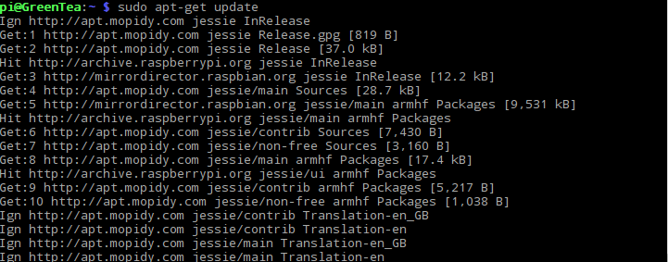
Installing Mopidy and all dependencies: First update pi

Slide 5
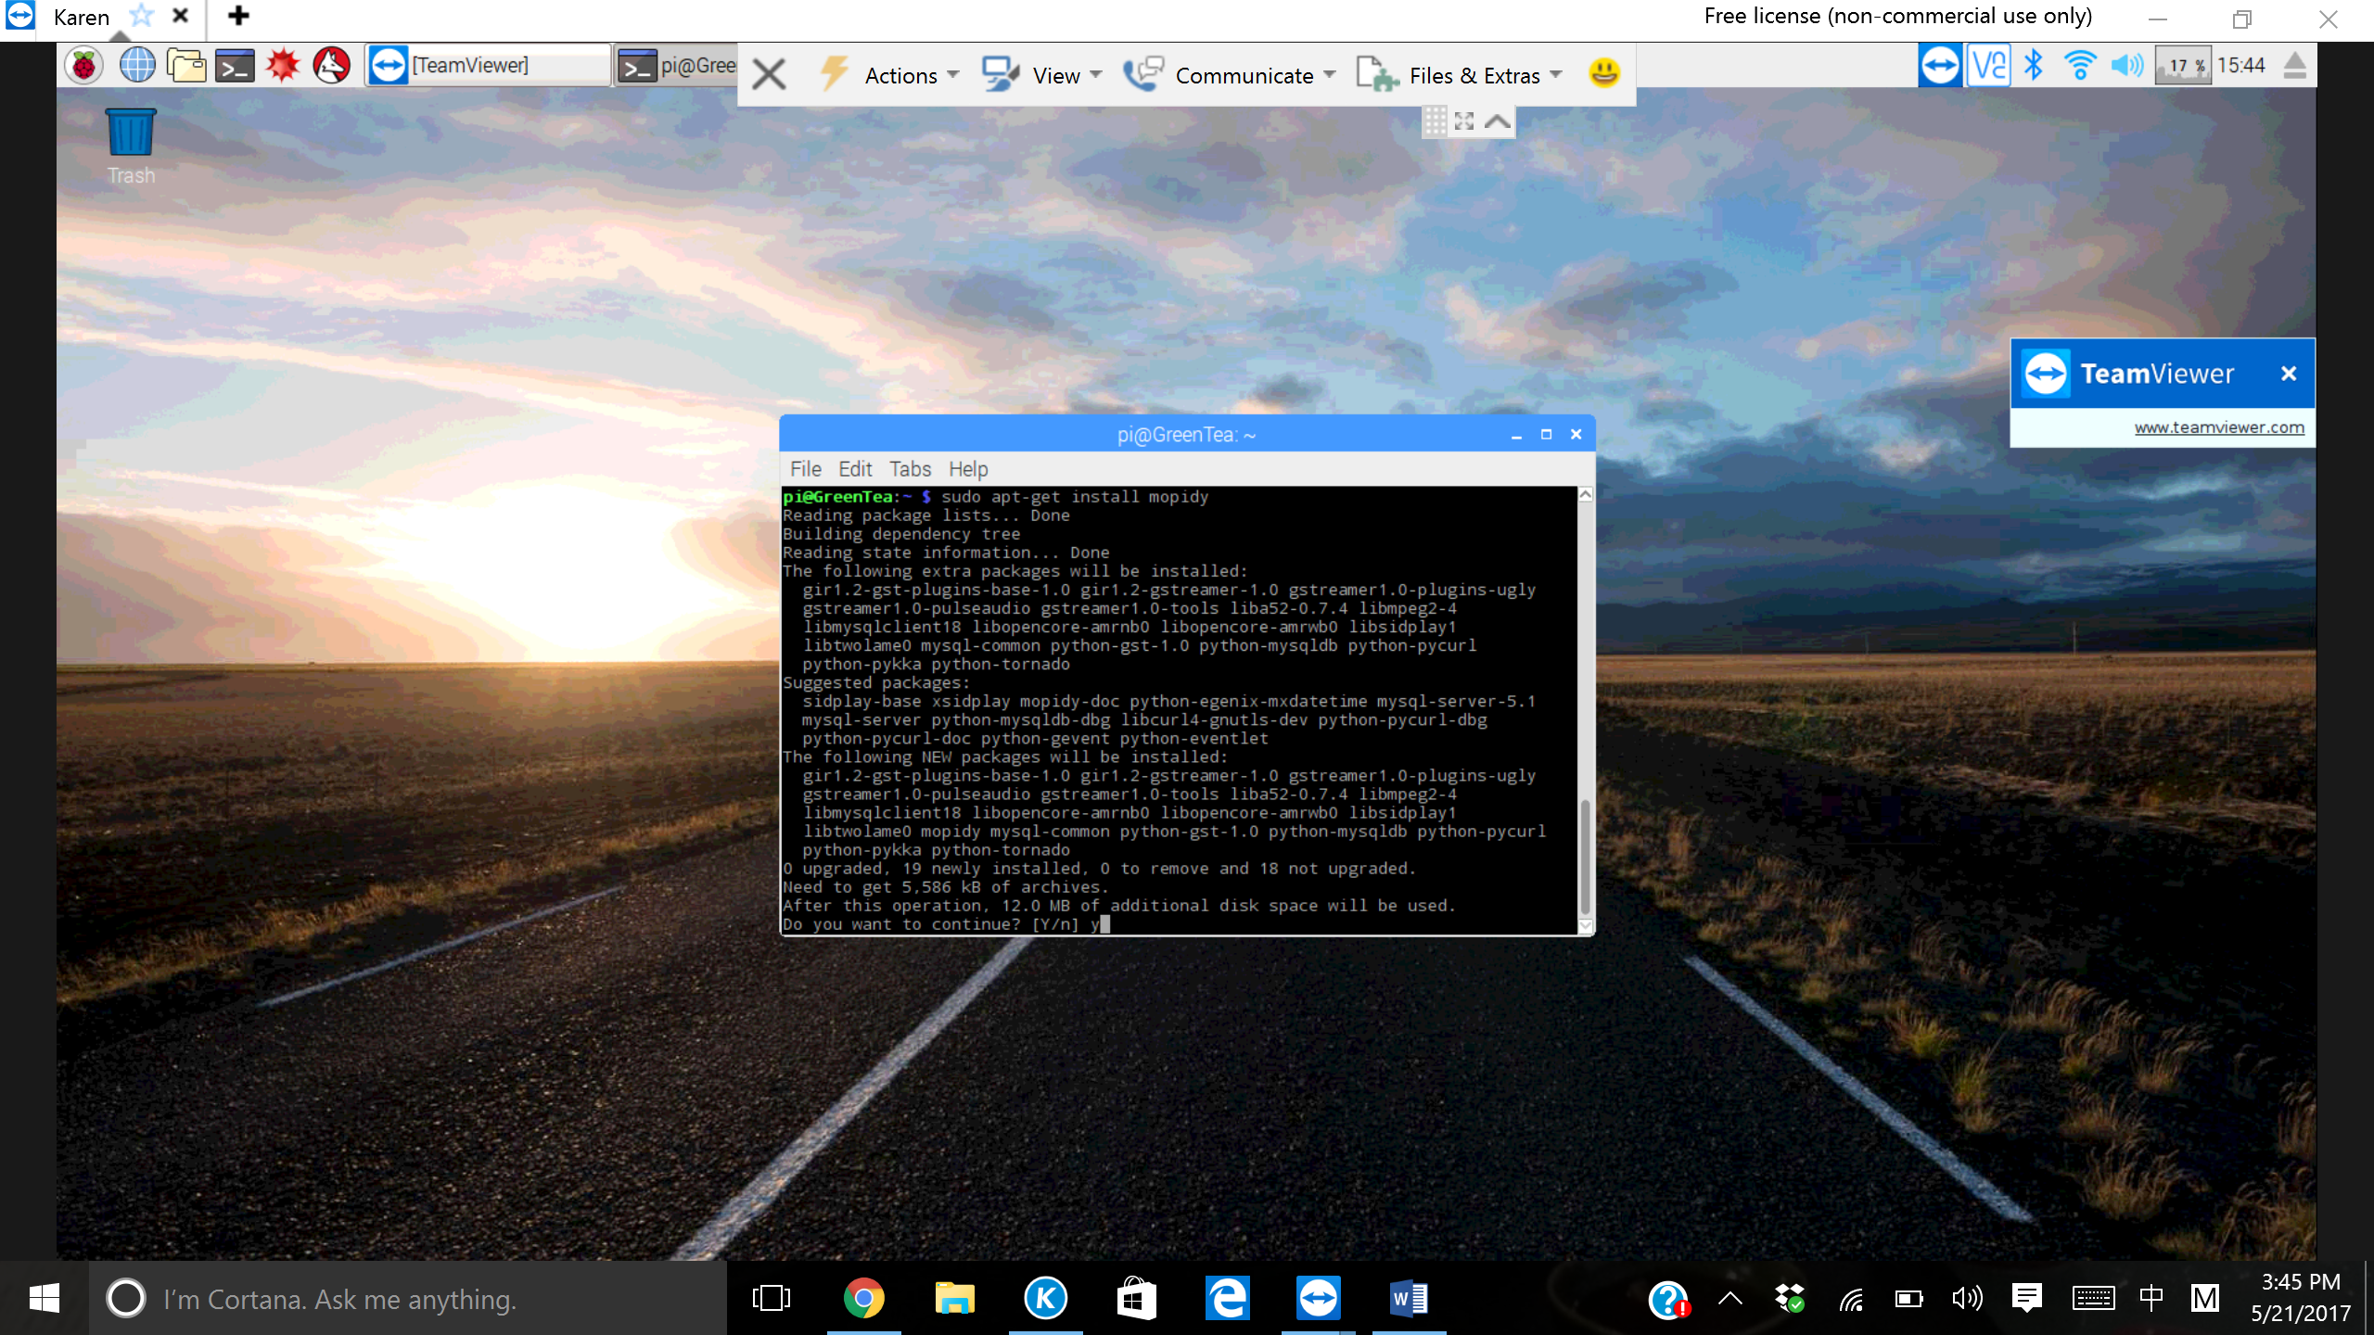
Then install Mopidy:
Official terminal command to get Mopidy

Slide 6
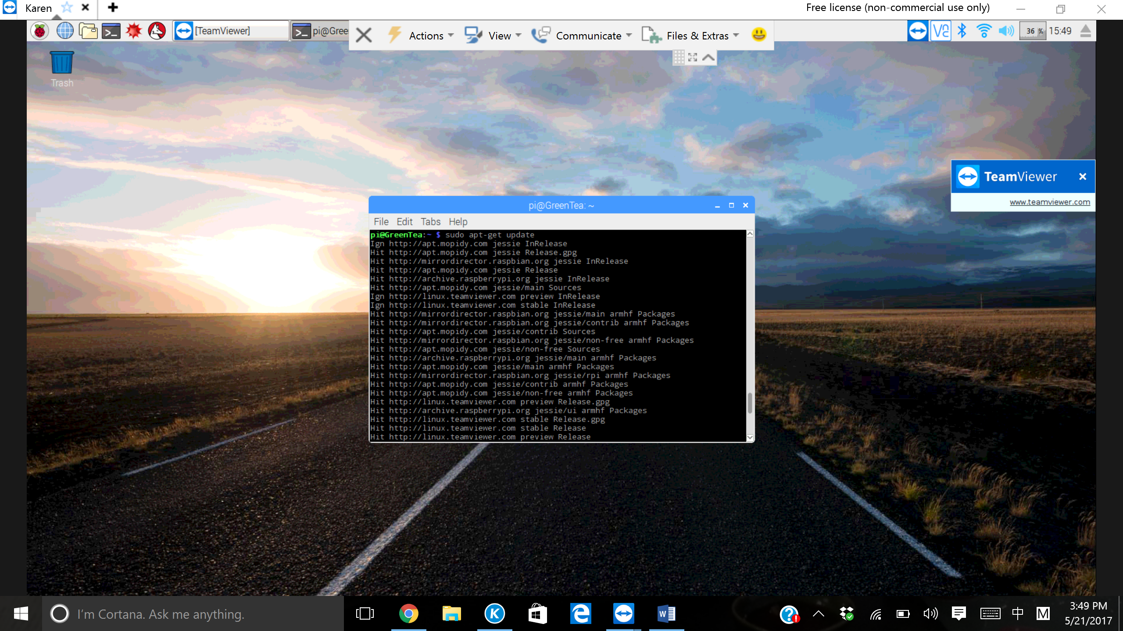
Update Rpi again for the next step:

Slide 7

Ensure Mopidy is latest version by updating it to a specific command:
Sudo apt-get dist-upgrade not only upgrades, it handles changing dependencies with new versions of packages. If necessary the ‘dist-upgrade’ command may remove some packages that are less important for the new files.

Slide 8
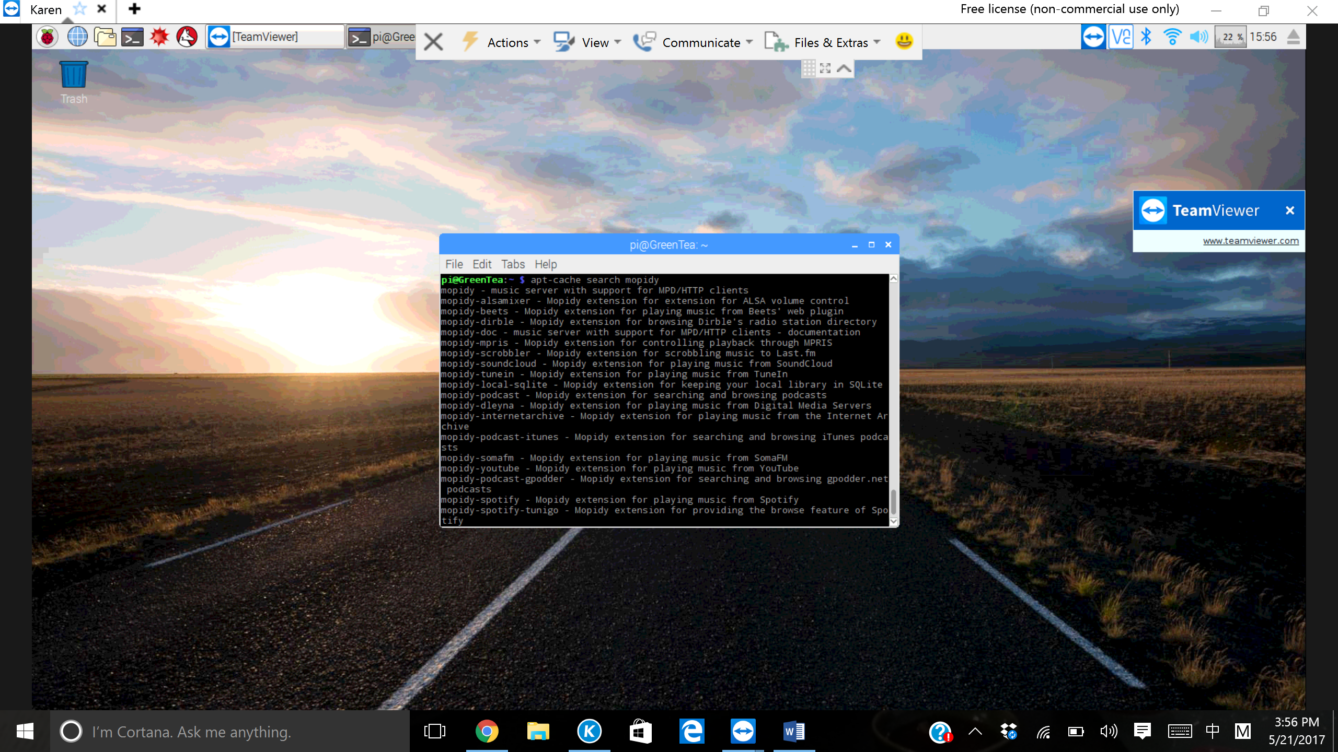
To list all the extensions available from apt.mopidy.com, a list of available extensions are found
While you enter this command, you
will see abundant of extensions that
you can use for your mopidy.
Another command to find more
Extensions will be ‘pip search mopidy’

Slide 9

For our Music Server, we installed Spotify:
One of our Music Streaming server
That we can install for use.

Slide 10
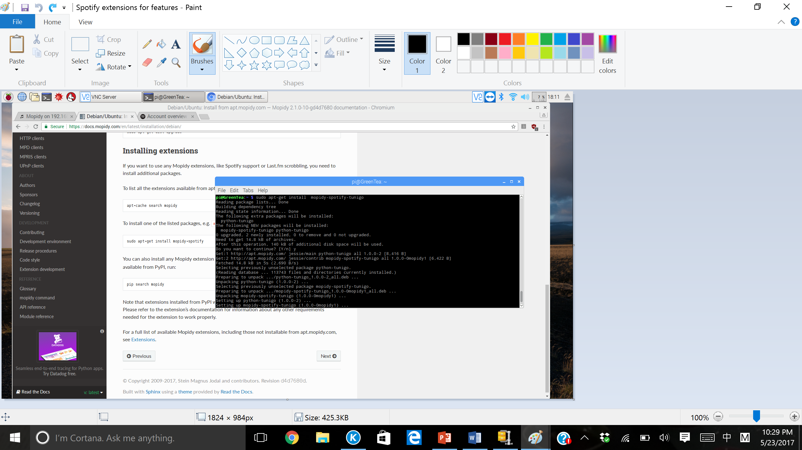
A Spotify feature extension:
Spotify browsing features.

Slide 11

And Youtube; This will also be our music streaming service.

Slide 12
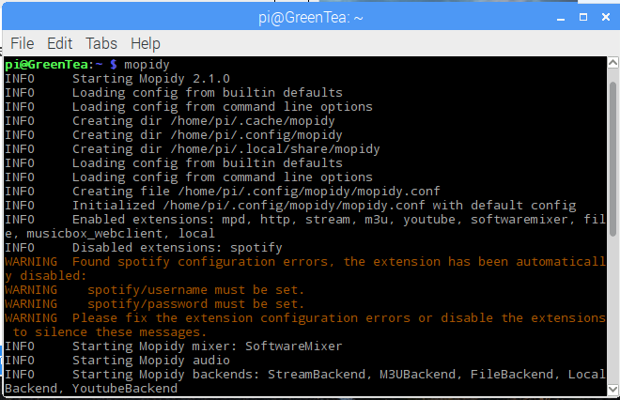
Running Mopidy through terminal
Running Mopidy will start creating
files for us to edit the systems of the
Mopidy itself using
Mopidy configurations.
Enter, ”ctrl-c” to stop mopidy

Slide 13
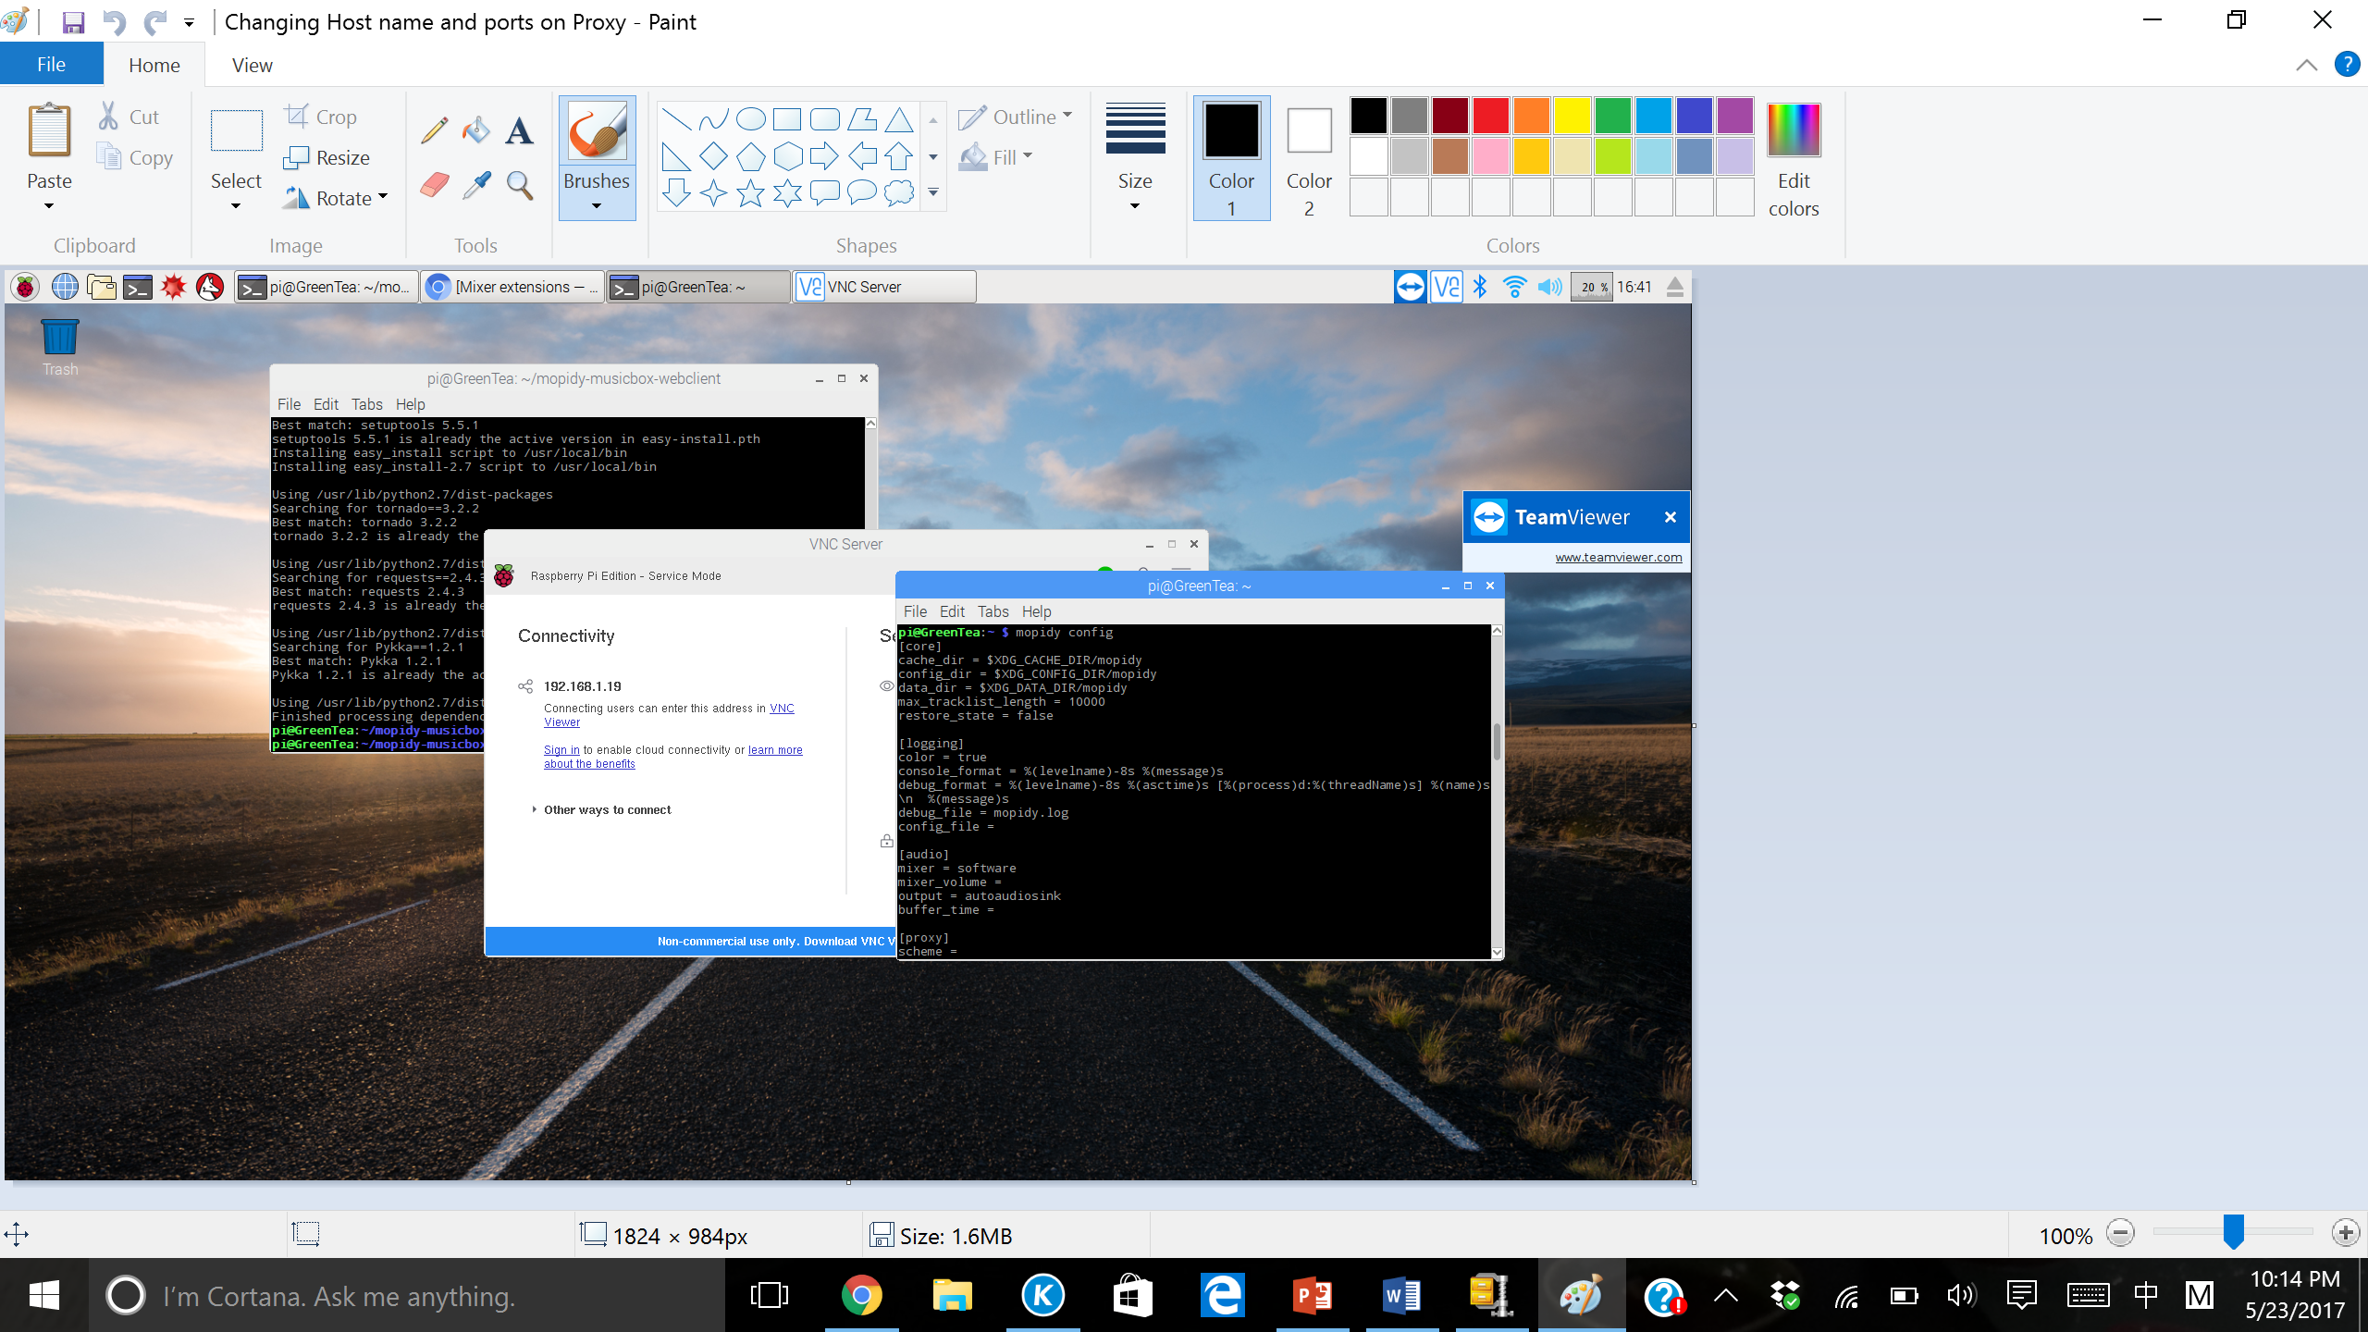

Changing host name and ports on http and mpd ONLY:

Slide 14

Configuring Spotify account

Slide 15
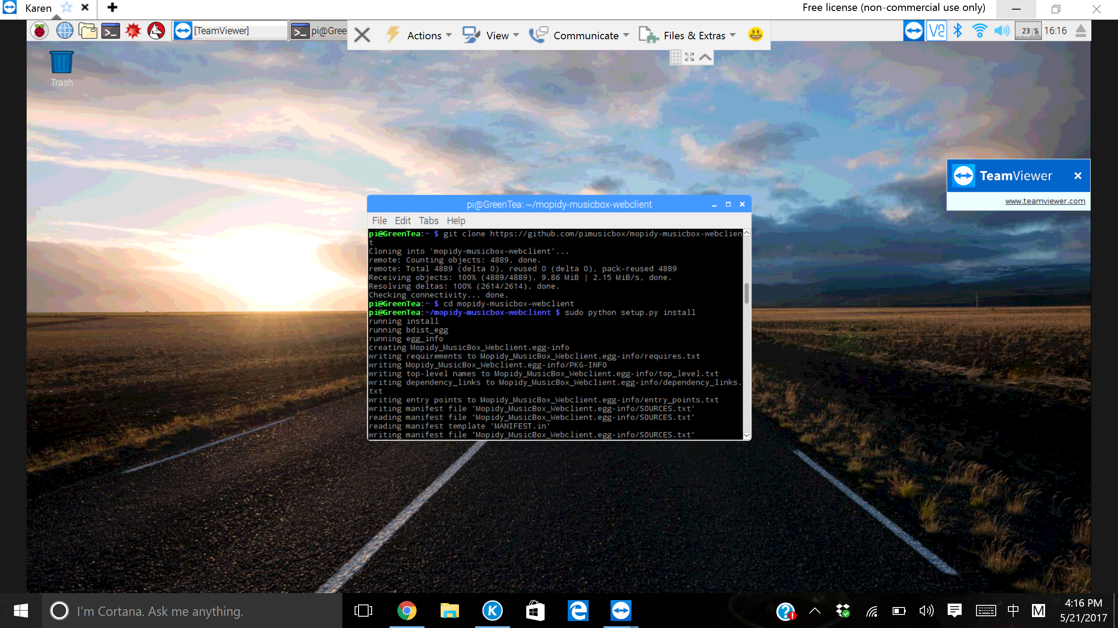
Using git clone to get Mopidy musicbox web client:
Go into the newly downloaded file:

Slide 16

Setups on Web client before you access one.

Slide 17
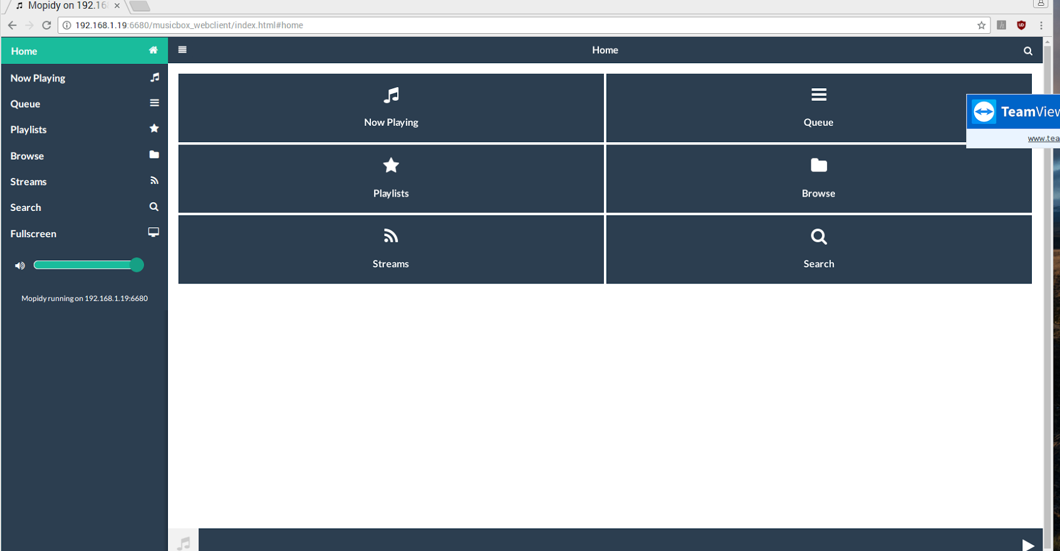
Opening Mopidy on web client:

Slide 18
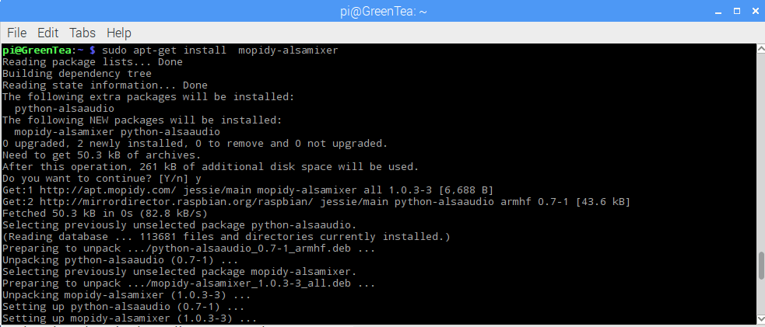
Installing alsamixer for volume control:

Slide 19

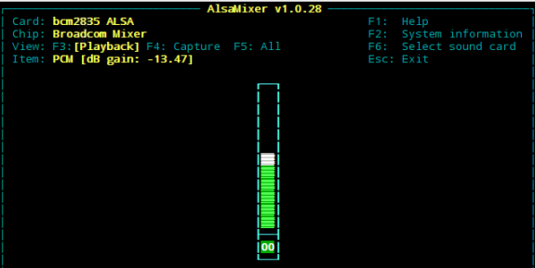
Controlling Volume

Slide 20
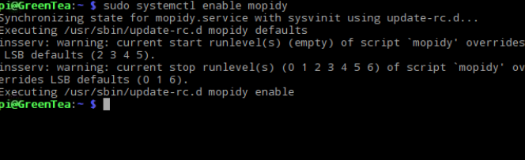
How to Boot Mopidy up when you log in.

